Slide 1

English for Telephoning
Class: 18C1-NNA1
Time: 14.10 – 15.40 on
Lecturer: Ms. Nguyen Thi Thanh Tu
Faculty of Foreign Languages
Ly Tu Trong College of Ho Chi Minh City
Unit 6: How does that sound?

Slide 2
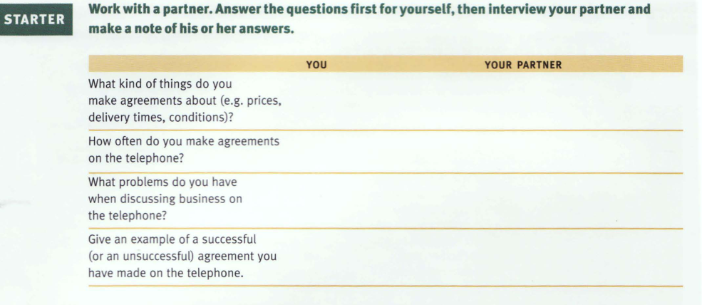

Slide 3
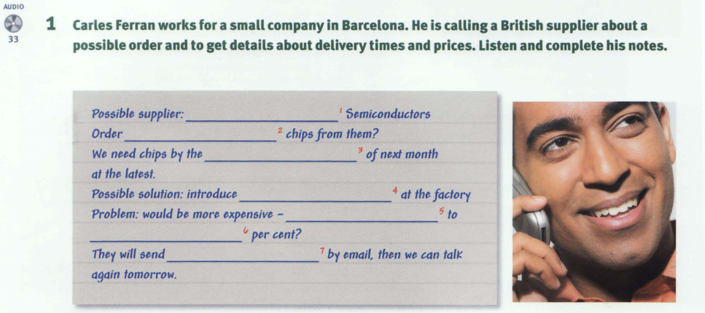
A &M
processor
middle
shift work
5 (five)
10 (ten)
quotation

Slide 5
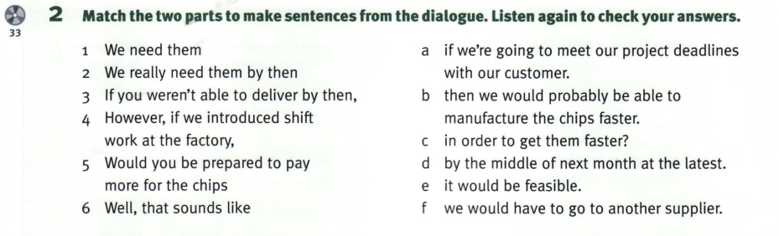
1d 2a 3f 4b 5c 6e

Slide 6
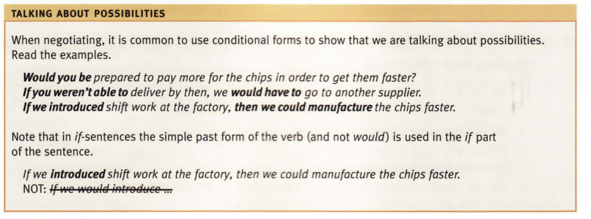

Slide 7

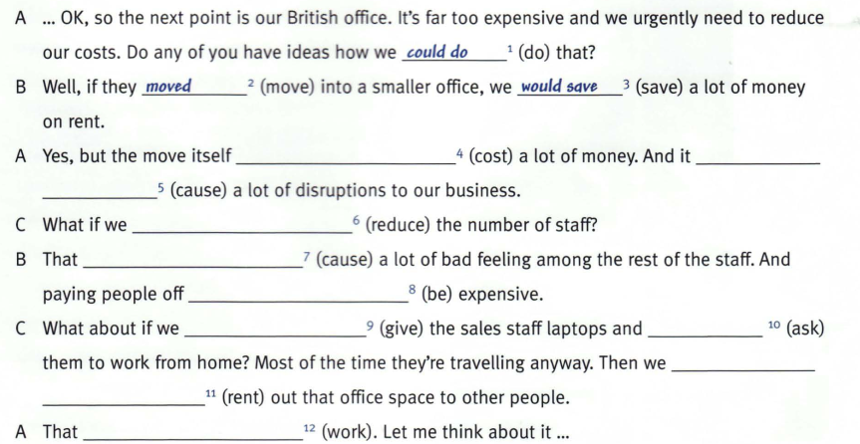
could cost
Could/would cause
reduced
Could/would cause
would be
gave
asked
Could rent
could

Slide 8
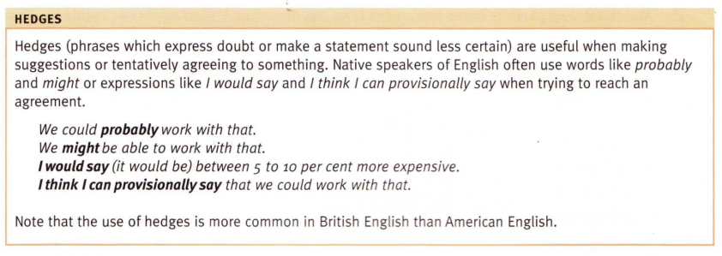

Slide 9
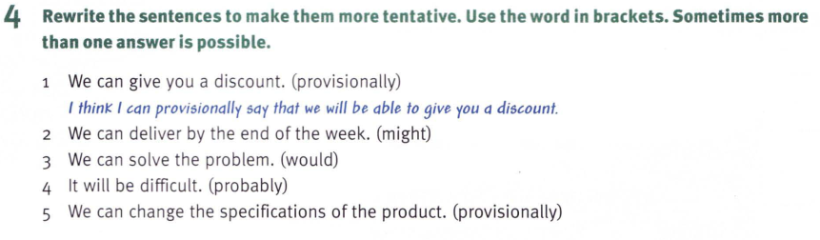
2. We might be able to deliver by the end of the week.
3. I would say that we can solve the problem.
4. It will probably be difficult.
5. I think I can provisionally say that we can change the specification of the product.

Slide 10
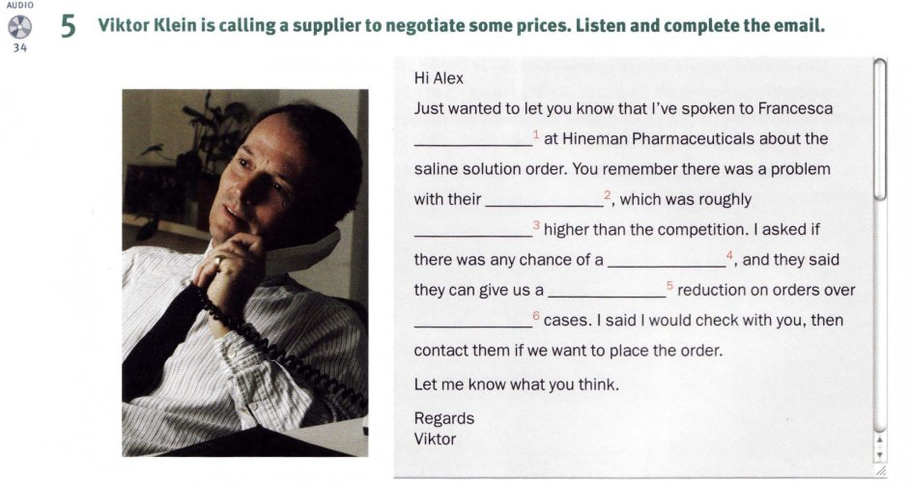
Davis
prices
ten per cent
discount
five per cent
500

Slide 11
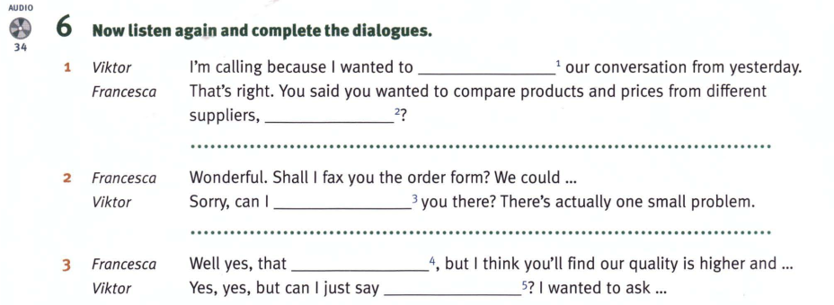
Follow up
didn’t
interrupt
may be true
something

Slide 12
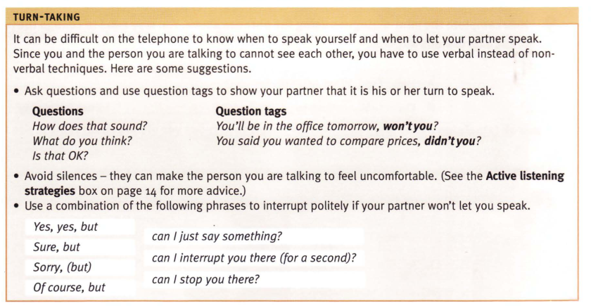

Slide 13
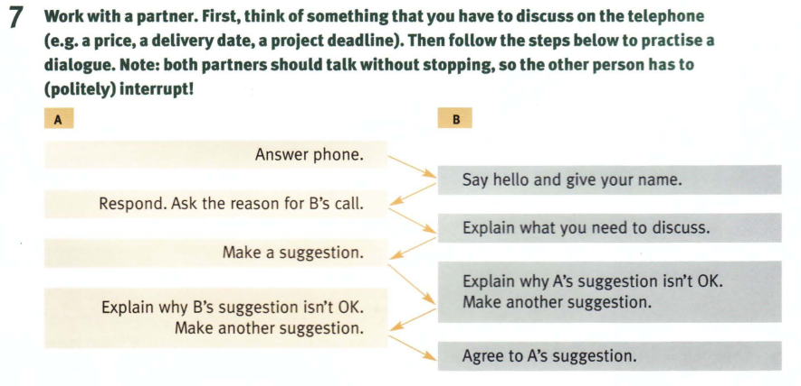

Slide 14
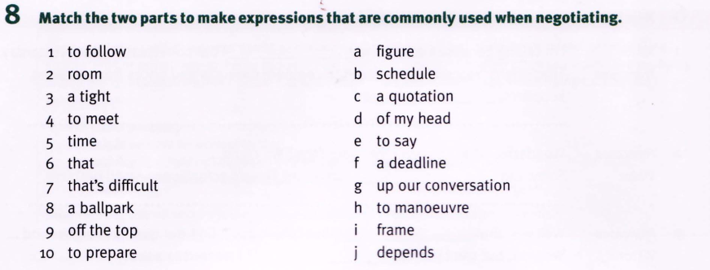
1.g 2. h 3b 4. f 5. i 6j 7 e 8 a 9d 10c

Slide 15
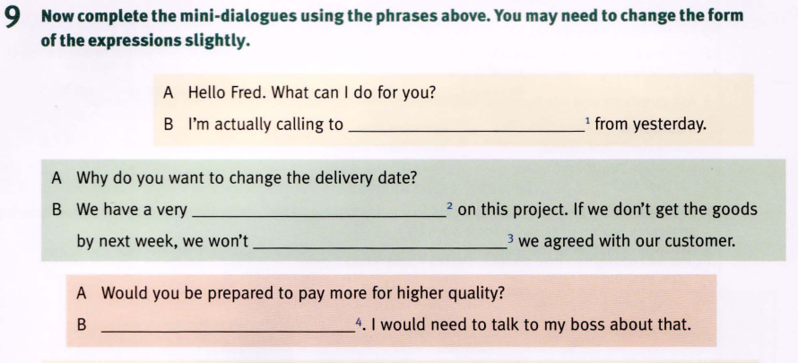

Slide 16
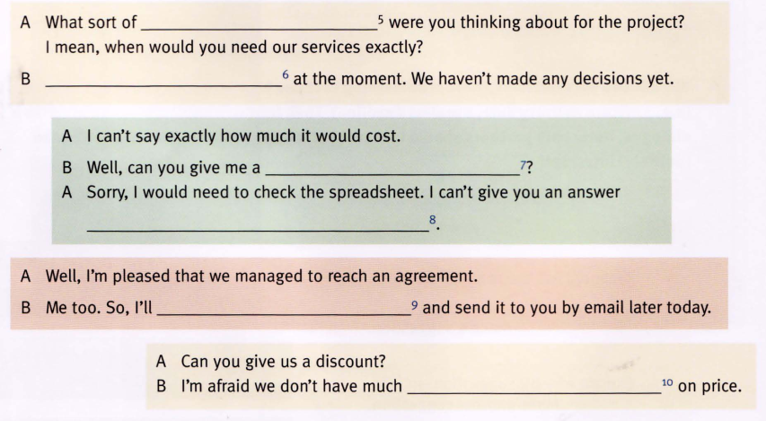

Slide 17
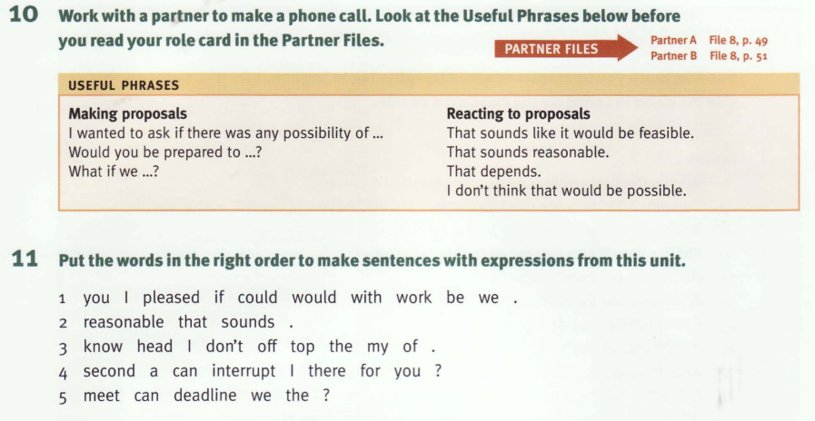

Slide 18
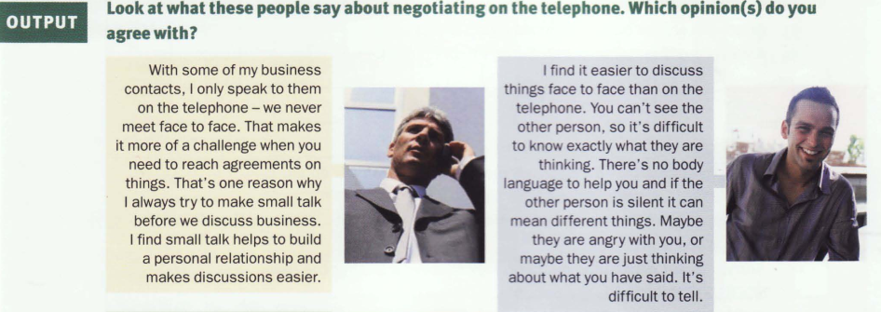

Slide 19
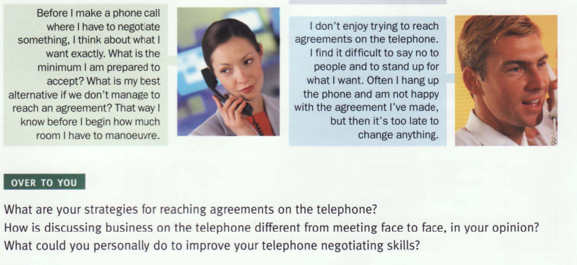

Slide 20
Homework:
After these two periods you have to learn all vocabulary.
Review for final test

